Slide 1

Lesson 13
SQL Stored Procedures
1

Slide 2
Stored Procedures
A database program module that are stored and executed by the DBMS at the database server.
A segment of SQL codes that can save and reuse over and over again instead of writing that query each time.
Help to save a SQL query which is frequently executed as a prepared SQL code and just execute it when needed.
Once created, stored procedures are compiled and stored in the database.

Slide 3
Stored Procedures
Help to increase the performance of the applications.
Has the ability to pass parameters depending on the requirement to handle different requests.
It can accept input parameters, return output values as parameters, or return success or failure status messages.

Slide 4
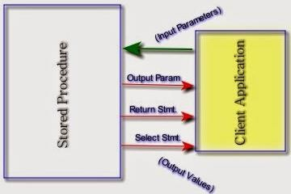
Stored Procedures
The communication between SQL Server Stored procedure and client application happens through parameters and return values.

Slide 5
Stored Procedure vs. SQL Statement
SQL Statement Stored Procedure
Creating
Check syntax
Compile
First Time
- Check syntax
- Compile
Execute
Return data
First Time
Execute
Return data
Second Time
- Check syntax
- Compile
Execute
Return data
Second Time
Execute
Return data

Slide 6
Stored Procedure Syntax
CREATE PROCEDURE <procedure name> (<parameters>)
AS
Required only
BEGIN
when multiple SQL statements are used within the body.
<procedure body>
END
Execute Procedure
EXEC <procedure name>

Slide 7
Create a Procedure
CREATE PROCEDURE spAll_Persons
AS
SELECT * FROM Employee
Call a Procedure
EXEC spAll_Persons

Slide 8
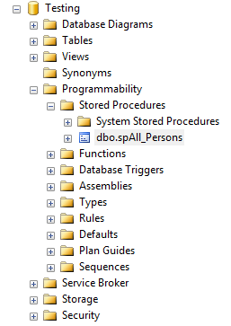
Procedure spAll_Persons

Slide 9
SQL Variables
A variable allows a programmer to store data temporarily during the execution of code.
Declare a variable:
DECLARE @variable_name <data_type> Eg: DECLARE @surname varchar(30)

Slide 10
Assign a value to a variable
SET @variable_name = <value>
Eg: SET @surname = ‘Smith’
Initialization of value is optional.
DECLARE @variable_name <data_type> = <initial _value> Eg: DECLARE @surname varchar(30) = ‘Smith’

Slide 11
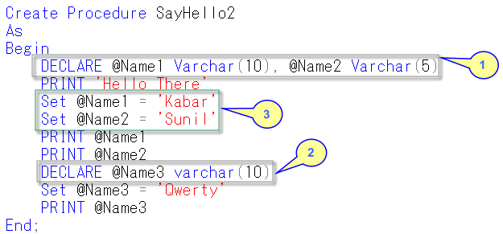
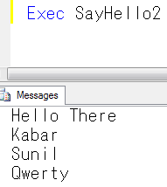
Example

Slide 12
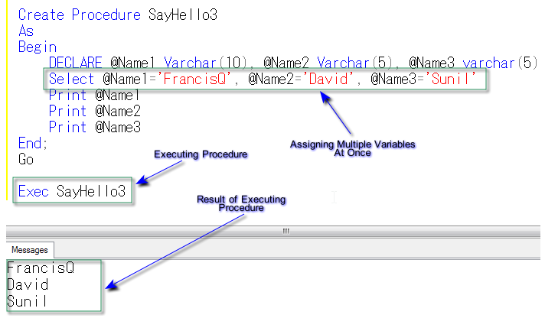
Example

Slide 13
Working with Parameters
CREATE PROCEDURE spFindEmployee
@id char(4)
AS
SELECT EmployeeName, Dno FROM Employee WHERE EmployeeID = @id

Slide 14
Executing Procedure with Parameters
EXEC spFindEmployee ‘E1’
EXEC spFindEmployee @id = ‘E2’

Slide 15
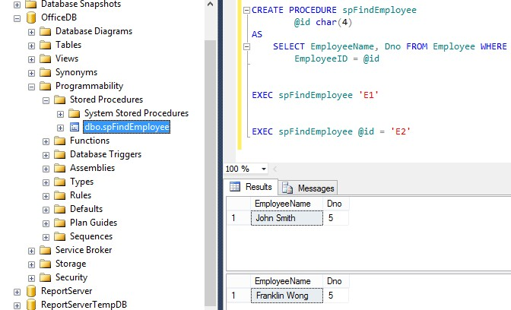

Slide 16
Working with Parameters
CREATE PROCEDURE spFindEmployee
@Surname varchar(30), @Dept int
AS
SELECT * FROM Employee WHERE Lname = @Surname AND Dno = @Dept

Slide 17
Executing Procedure with Parameters
Passing Argument by Ordinal Position
The parameter passing order is important.
EXEC spFindEmployee ‘Smith’, 2
Passing Named Arguments
The order is not important
EXEC spFindEmployee @Dept = 2,
@Surname = ‘Smith’

Slide 18
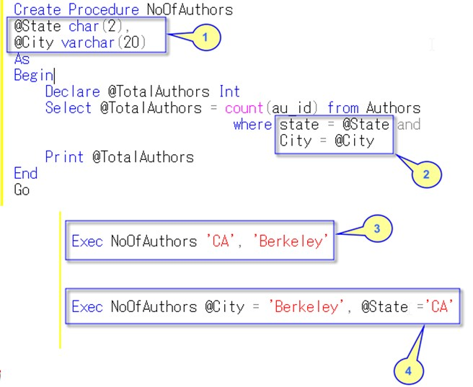
Example

Slide 19
Default Parameter Values
CREATE PROCEDURE spFindEmployee @Surname varchar(30) = ‘Smith’
AS
SELECT * FROM Employee WHERE Lname = @Surname

Slide 20
Executing Procedure with Default Value
EXEC spFindEmployee ‘Wong’
EXEC spFindEmployee

Slide 21
Default Parameter with NULL Values
CREATE PROCEDURE spFindEmployee @Surname varchar(30) = NULL
AS
SELECT * FROM Employee WHERE Lname = @Surname
EXEC spFindEmployee
This will display the records where surname is NULL.

Slide 22
Stored Procedure with Return statement
CREATE PROCEDURE spFindEmployeeCount @dno int
AS
BEGIN
DECLARE @employeeCount int SELECT @employeeCount = COUNT(*) FROM Employee
WHERE Dno= @dno RETURN @employeeCount
END

Slide 23
Execution
DECLARE @empCount int
EXEC @empCount = spFindEmployeeCount 5
To see the output:
SELECT @empCount PRINT @empCount

Slide 24
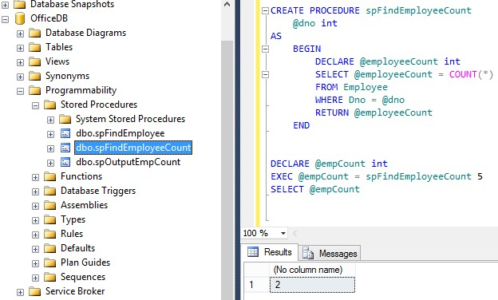

Slide 25
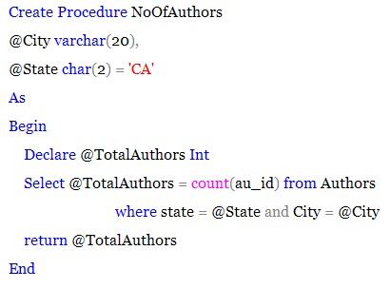
Example

Slide 26
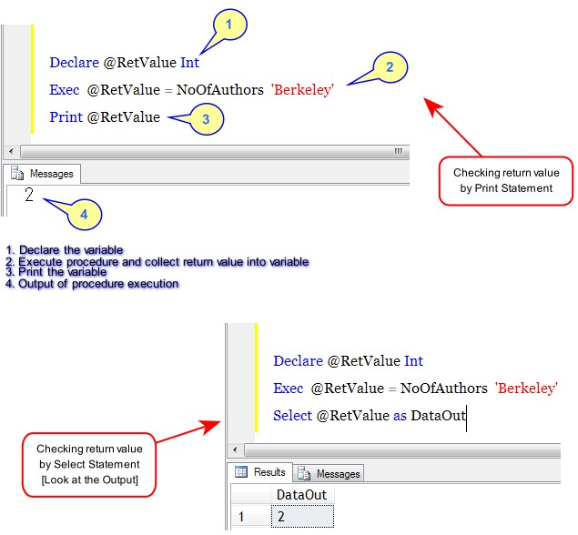

Slide 27
Output Parameter values
The output clause can be used to specify output parameters.
Use the "OUTPUT" or just "OUT” clause after the parameter name to specify that it should return a value.

Slide 28
Working with OUT Parameters
CREATE PROCEDURE spOutputEmpCount @dno int,
@employeeCount int OUTPUT
AS
SELECT @employeeCount = COUNT(*) FROM Employee
WHERE Lname = @surname

Slide 29
Execution
DECLARE @eCount int
EXEC spFindEmployeeCount ‘Smith’,
@eCount OUTPUT
To see the output:
SELECT @eCount

Slide 30
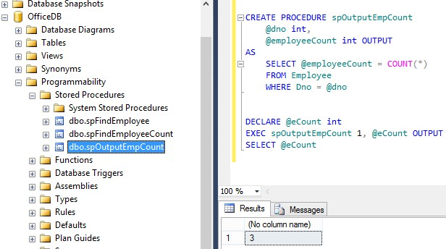

Slide 31
Execution
DECLARE @eCount int
EXEC spFindEmployeeCount @surname = ‘Smith',
@employeeCount = @eCount OUTPUT
To see the output:
SELECT @eCount

Slide 32
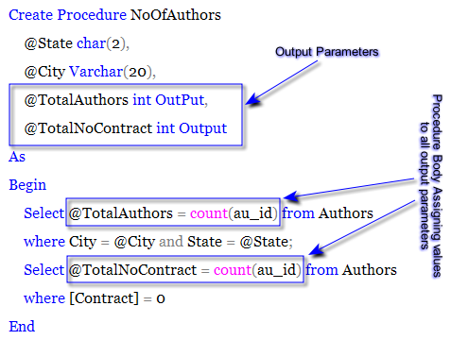
Example

Slide 33
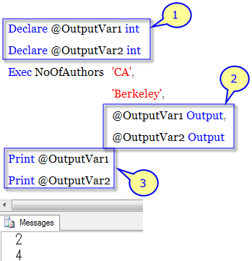
Example

Slide 34
Stored Procedure vs. UDF
Stored Procedures are compiled only in the first time and execute the saved compiled code each time. But Functions are compiled and executed every time when it is called.
Function must return a value. But it is optional for a Stored Procedure (Procedure can return zero or n values).
Procedures can have input/output parameters whereas functions can have only input parameters.
Procedure allows select as well as DML statement in it whereas function allows only select statement in it.

Slide 35
Stored Procedure vs. UDF
•
Functions can be called from procedure whereas Procedures cannot be called from Function.
•
UDF can be used in the SQL statements anywhere in the WHERE/HAVING/SELECT section where as Stored procedures cannot be.
•
Exception can be handled by try-catch block in a Procedure whereas try-catch block cannot be used in a Function.

Slide 36
Thank You
36

